Slide 1
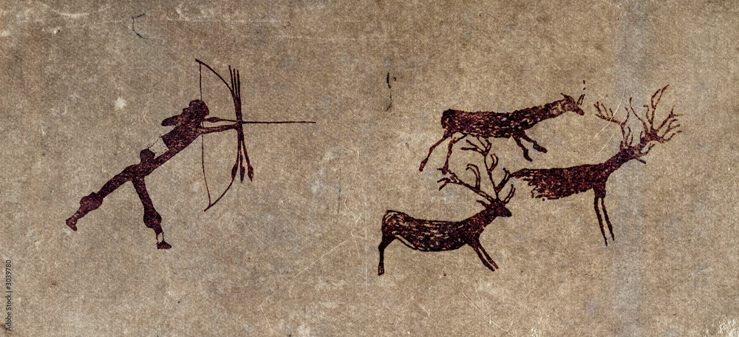
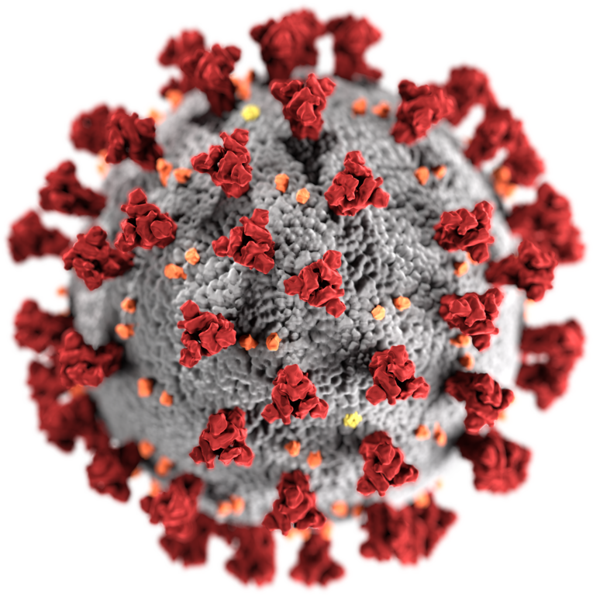
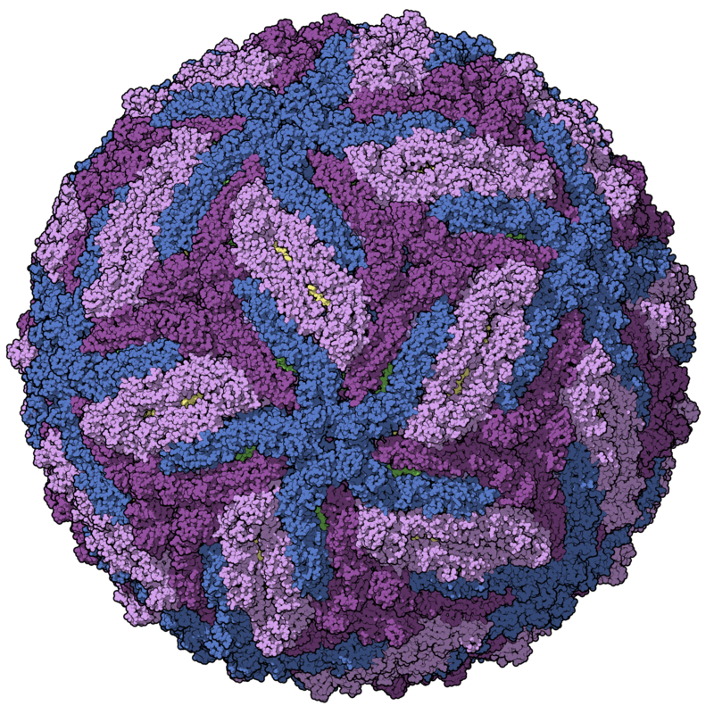
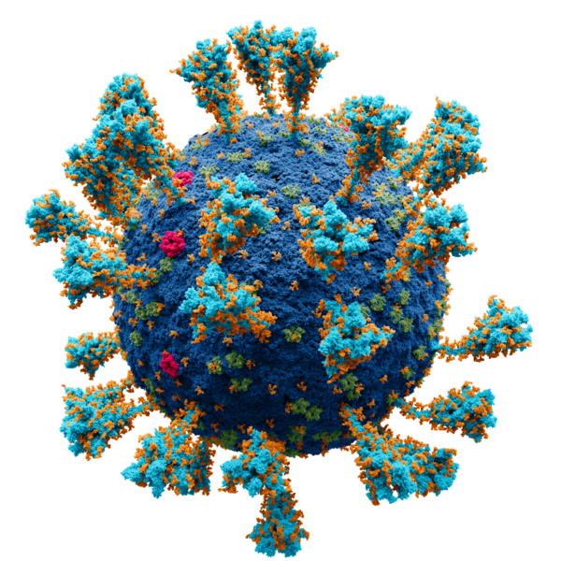
Characterization of the virome after liver
transplantation
VirushunterGatherer and Virusparies
Sergej Ruff
Twincore - RG Computational Virology
22 August 2024
Notes:
→ Good Morning
→ Today, Presenting the current progress of my master thesis, which I started almost 2 months ago.
→ Topic is the characterization of the virome after liver transplantation
→The Taubert Working Group at the MHH were so kind to provide me with liver Sequencing data
→ and I am applying VirushunterGatherer to characterize the virome of those samples and maybe find novel viruses.
→ Then I am plotting and analysing the output using a small R package I created called Virusparies.

Slide 2
Characterzation of the virome,VirusHunterGatherer and Virusparies - Outline
Methods and Material used
Reminder: VirusHunterGatherer and Hittables
Taubert Data
Mammal Data
Results
SRA Data
Taubert
Virusparies Package
3. Concluson and Outlook
Notes:
The outline of the presentation
Follows the classic Paper/ Journal Structure.
First → Talk about the motivation behind virus discovery.
Second → Then I want to talk about the history of viral discovery real quick and how it applyes to vhvg.
Method → Talk about the data and changes made to VhVg. Present the output of VhVg that I used for further analysis.
Results
Conclusion and Outlook.

Slide 3
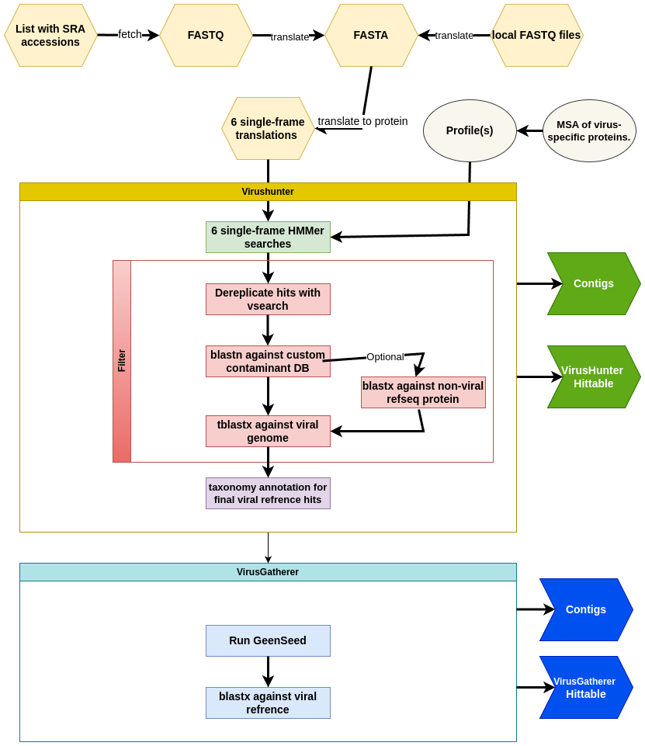

Reminder: VirusHunterGatherer
Local Taubert and Pfaff Data
Mammal SRA IDs
Hittables
Hittables
Virusparies
Virusparies

Slide 4
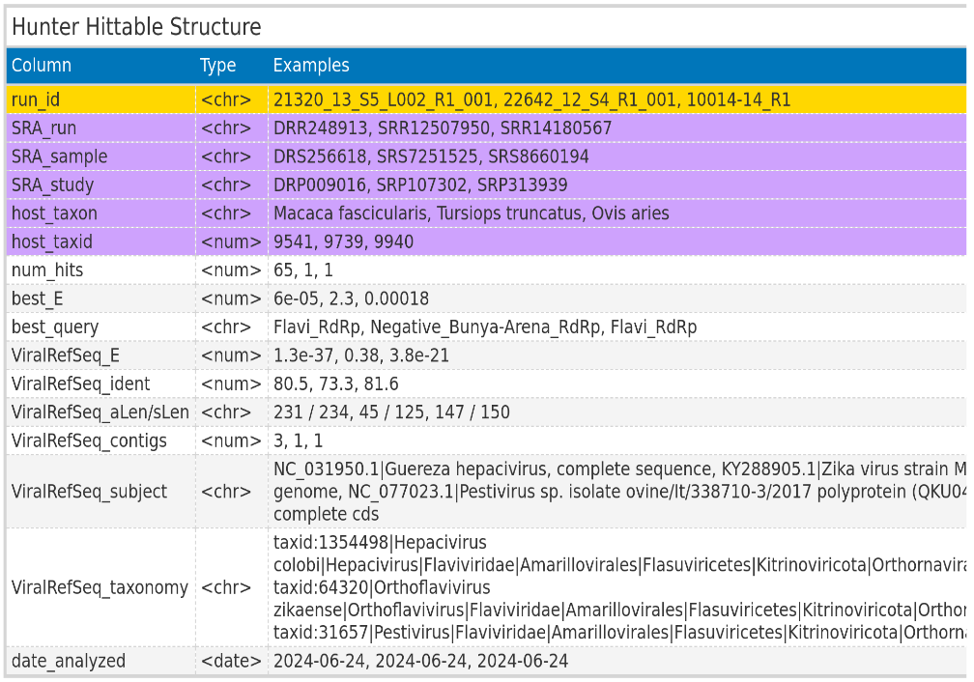
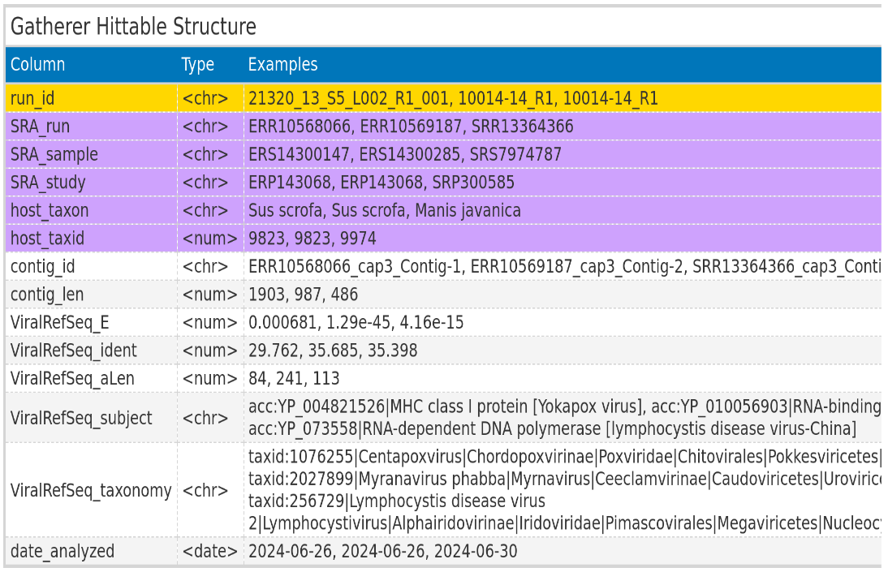
Reminder: Hittables
ViralRefSeq_taxonomy processed to extract virus family

Slide 5
Taubert Data
Local files from AG Taubert
Samples: Liver
All 3 Virus groups
Notes:
→ Start with Intro.
→ (click): Why do we need Virus discovery
→ An obvious Reason is the discovery of disease causing viruses → Especially Pandemic causing once (click)

Slide 6
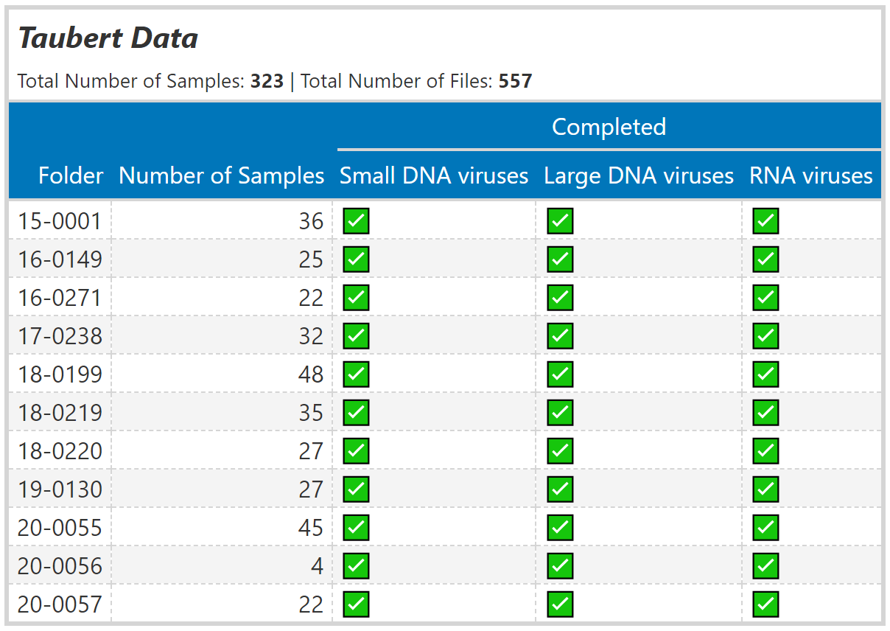
Material used: Taubert Data
Notes:
Sample nicht FASTQ-files

Slide 7
Mammal Data
SRA IDs re-examined from existing Hittable
RNA viruses only
Notes:
→ Start with Intro.
→ (click): Why do we need Virus discovery
→ An obvious Reason is the discovery of disease causing viruses → Especially Pandemic causing once (click)

Slide 8
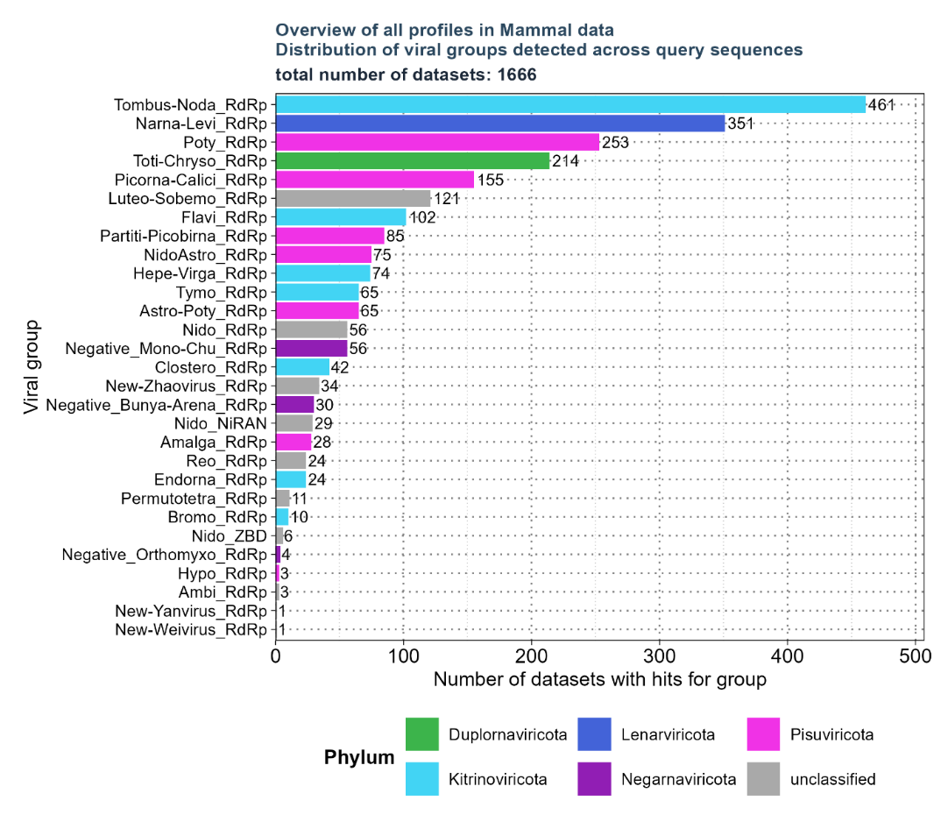
Material used: Mammal Data – overview of existing hittable.
Selected profiles:
Flavi_RdRp
Hepe-Virga_RdRp
Nido_RdRp
Negative_Bunya-Arena_RdRp
Negative_Mono-Chu_RdRp
Negative_Orthomyxo_RdRp
Nido_NiRAN
NidoAstro_RdRp
Existing Hittable:
34.337 unique SRA Ids
Filtered based on:
'num_hits' > 4
'ViralRefSeq_E' < 1e-5
'ViralRefSeq_ident' < 90

Slide 9
Florian Pfaff Data
Local files from Institute of Diagnostic Virology (Friedrich-Loeffler-Institut)
Samples: Wild boars
All 3 Virus groups
Notes:
→ Start with Intro.
→ (click): Why do we need Virus discovery
→ An obvious Reason is the discovery of disease causing viruses → Especially Pandemic causing once (click)

Slide 10
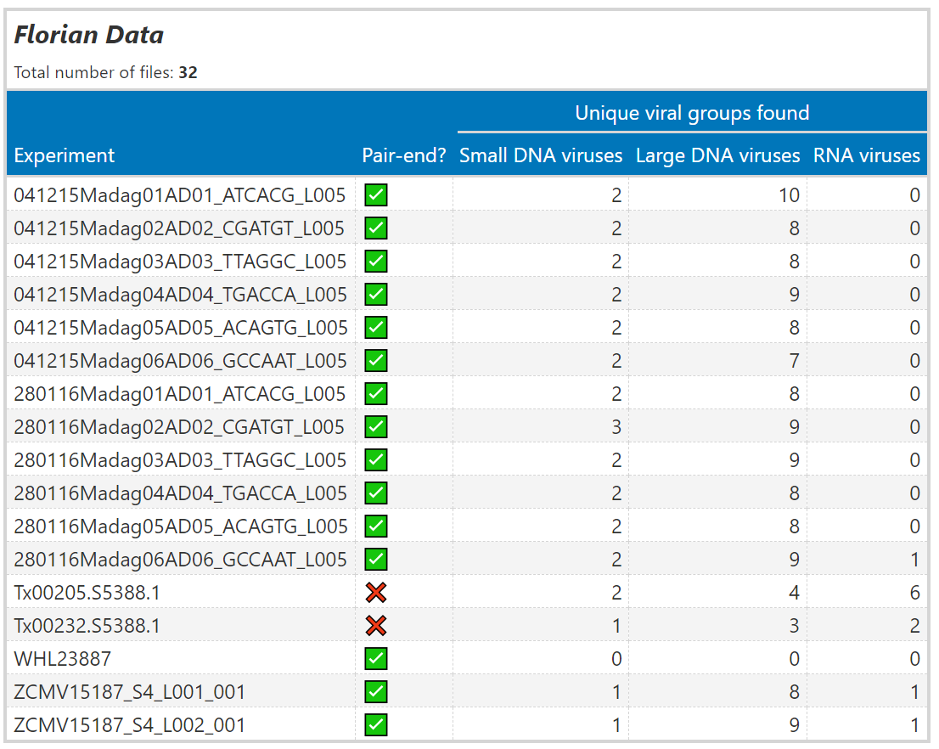
Material used: Florian Pfaff Data
Notes:
Sample nicht FASTQ-files

Slide 11
Results: Taubert

Slide 12
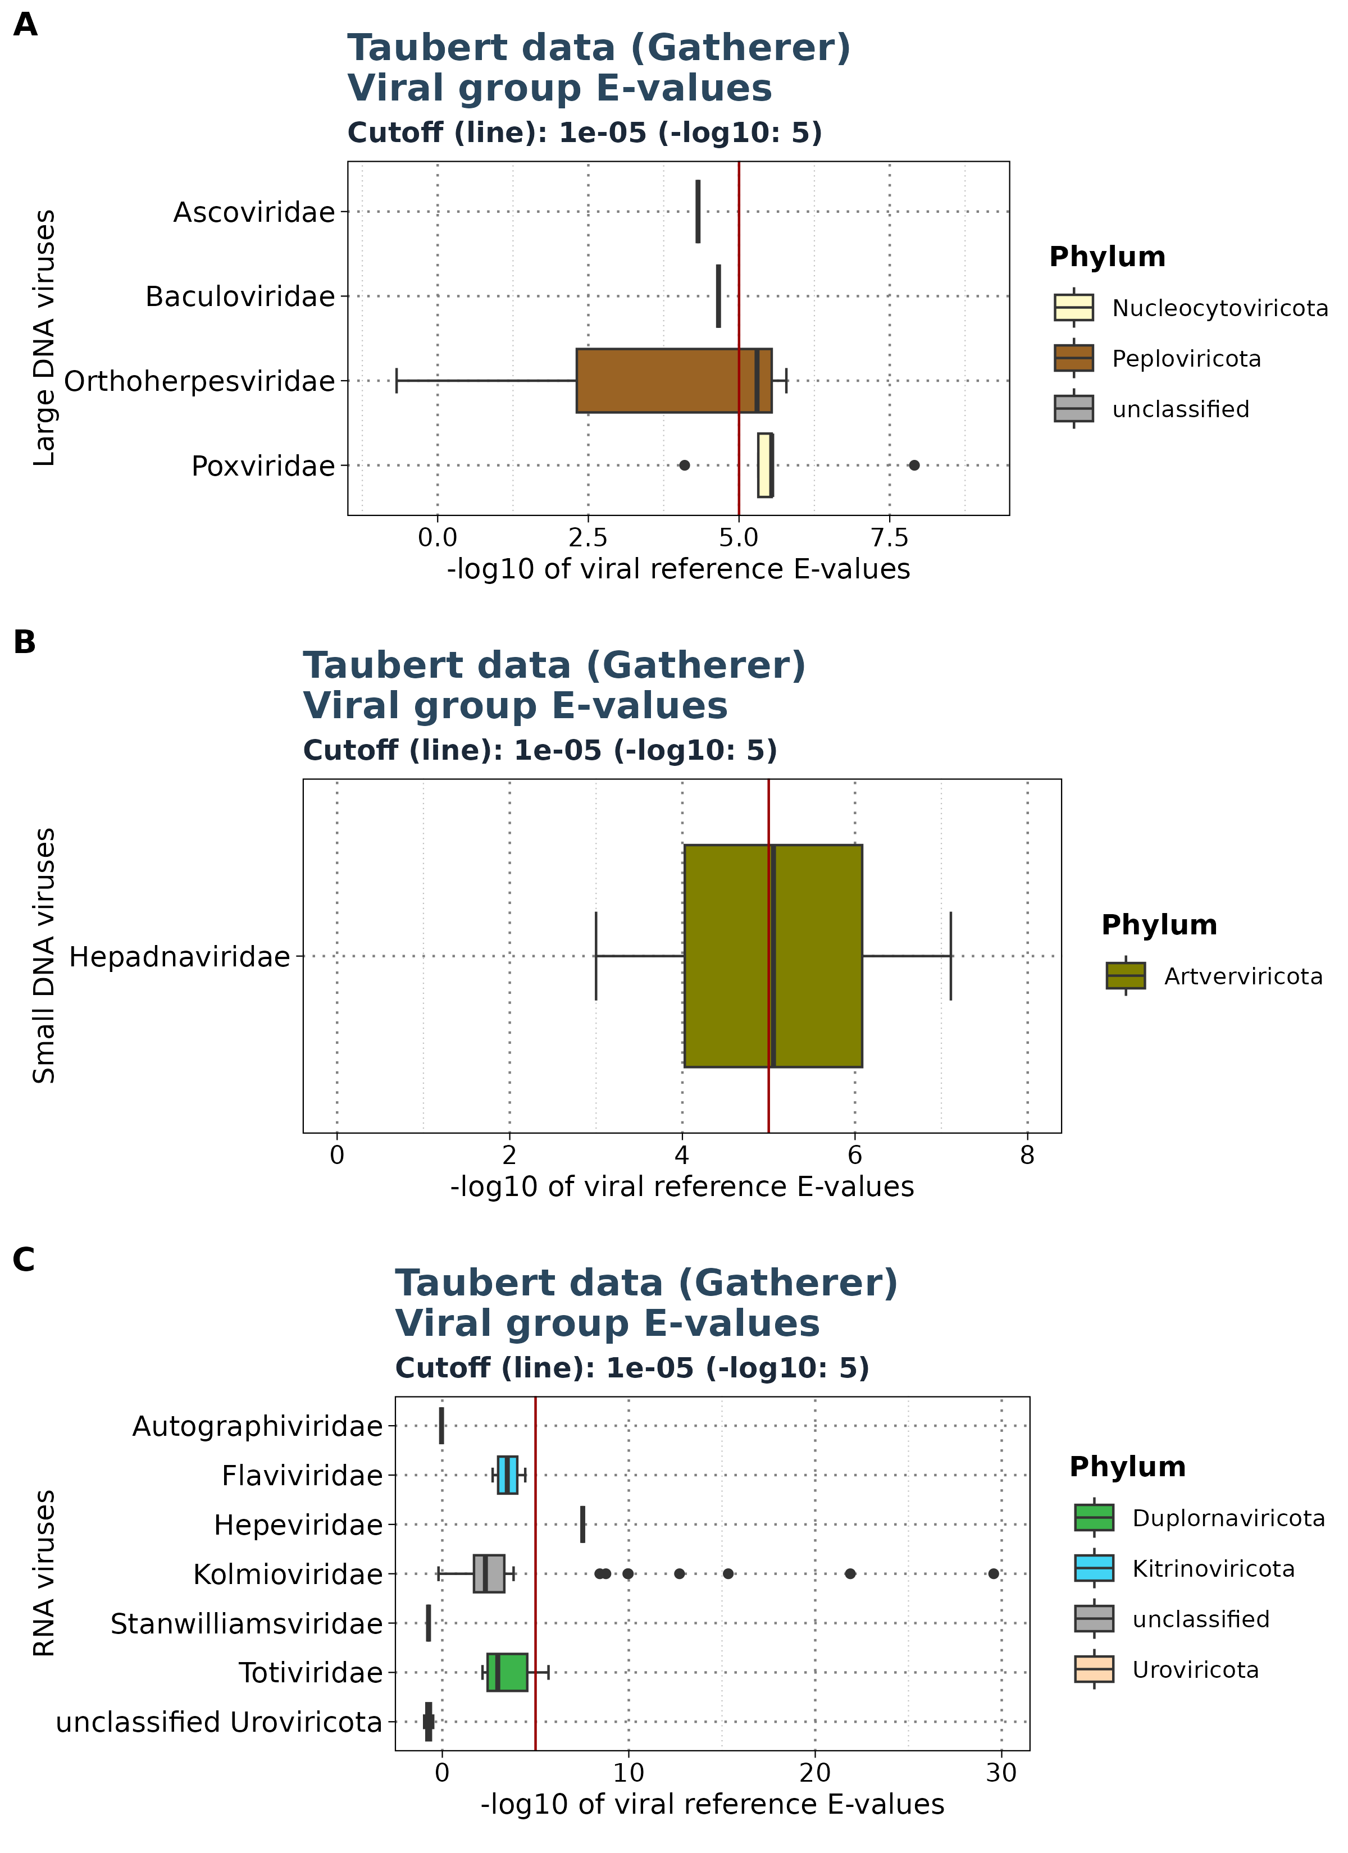
Results: Taubert - E-values
Showing only Gatherer results
Viral reference E-values for each group
Notes:
Braucht man für jedes Bild einen Titel hier. Vielleicht kann ich es in der Arbeit auch in Beschreibung packen.

Slide 13
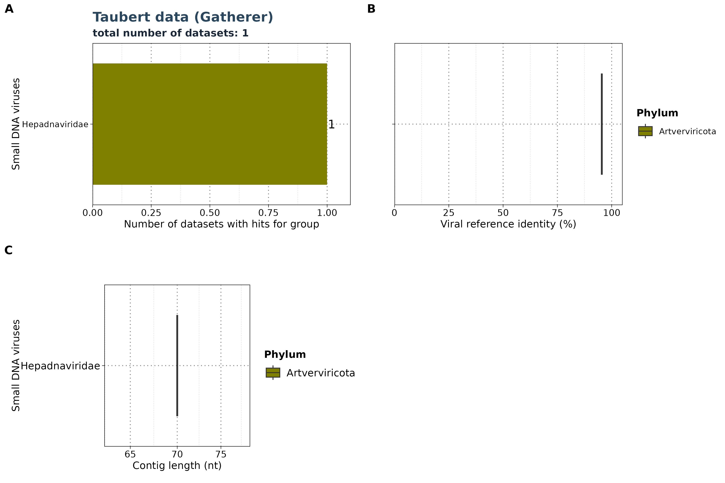
Results: Taubert
Small DNA viruses
Notes:
Viral Group entferen in dem B plot bei allen Datensätzen

Slide 14
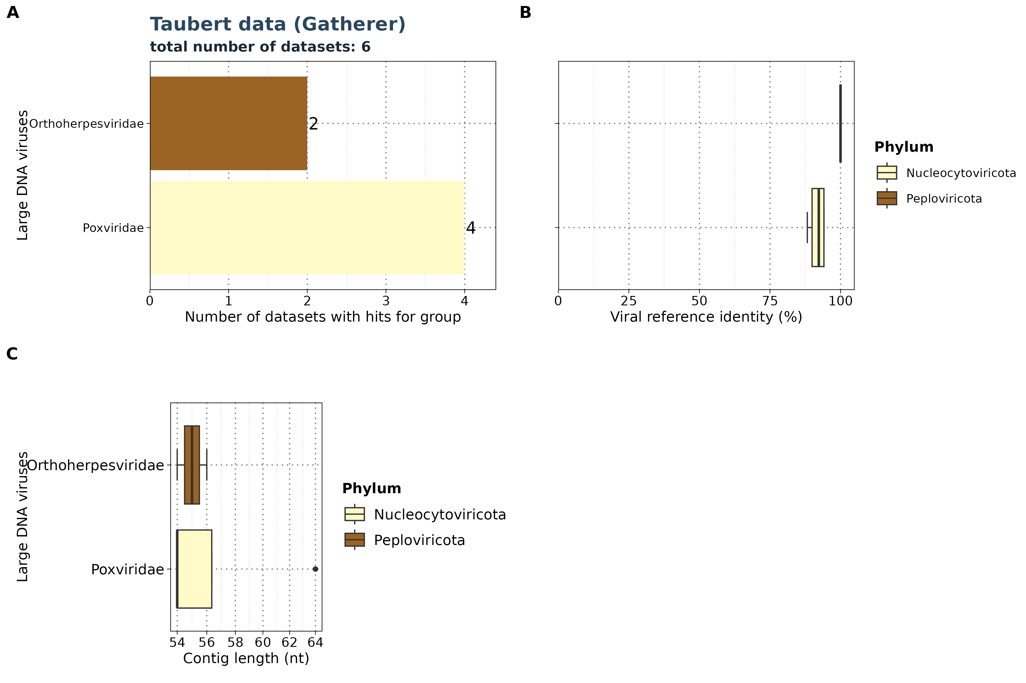
Results: Taubert
Large DNA viruses
Notes:
Viral Group entferen in dem B plot bei allen Datensätzen

Slide 15
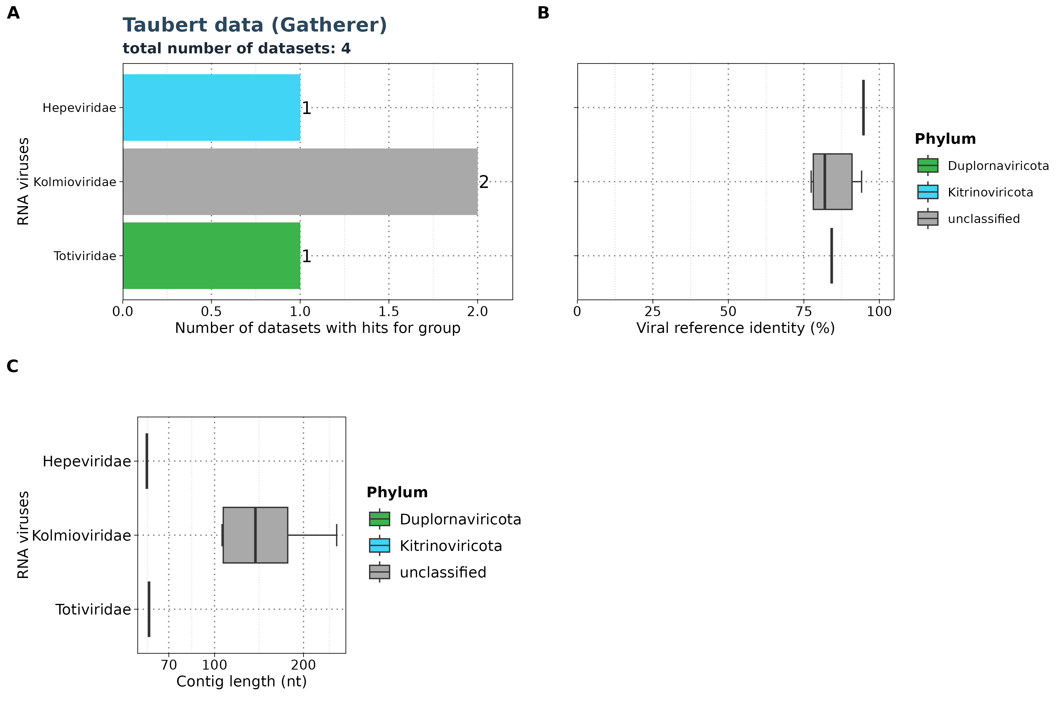
Results: Taubert
RNA viruses
Notes:
Viral Group entferen in dem B plot bei allen Datensätzen

Slide 16
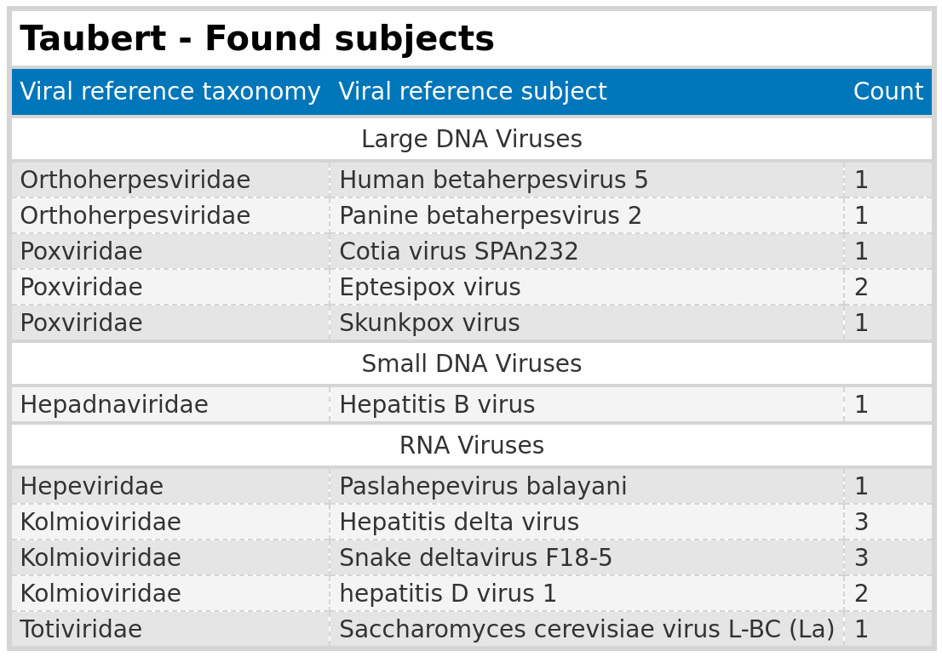
Results: Taubert
Subjects found

Slide 17
Results: Taubert
Summary
Analysis Summary: Completed analysis of Taubert data for small DNA, large DNA, and RNA viruses
Data Overview: Out of 557 FASTQ files, only a maximum of 6 files yielded significant results
Significance Threshold: Significant results were close to the E-value cutoff of 1e-5
Contig Lengths: Identified contigs were all below 200 nt
False Positives: Detected false positive groups, such as Totiviridae (yeast virus)
Cross-Group Findings: Poxviridae appeared in both the small and large DNA virus groups

Slide 18
Results: Mammal

Slide 19
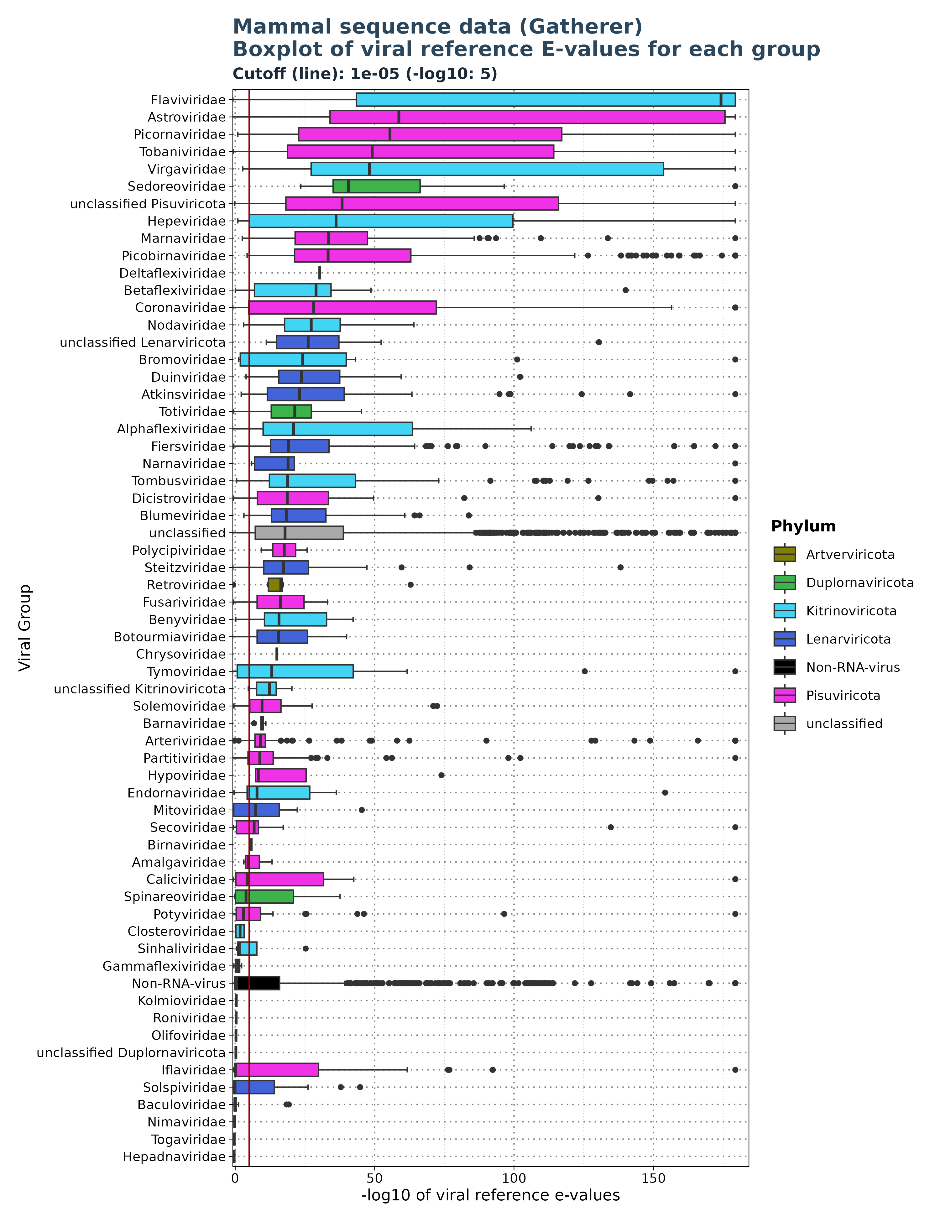
Results: Mammal – E-values
Viral reference E-values for
each viral groups
Cutoff: 1e-5

Slide 20
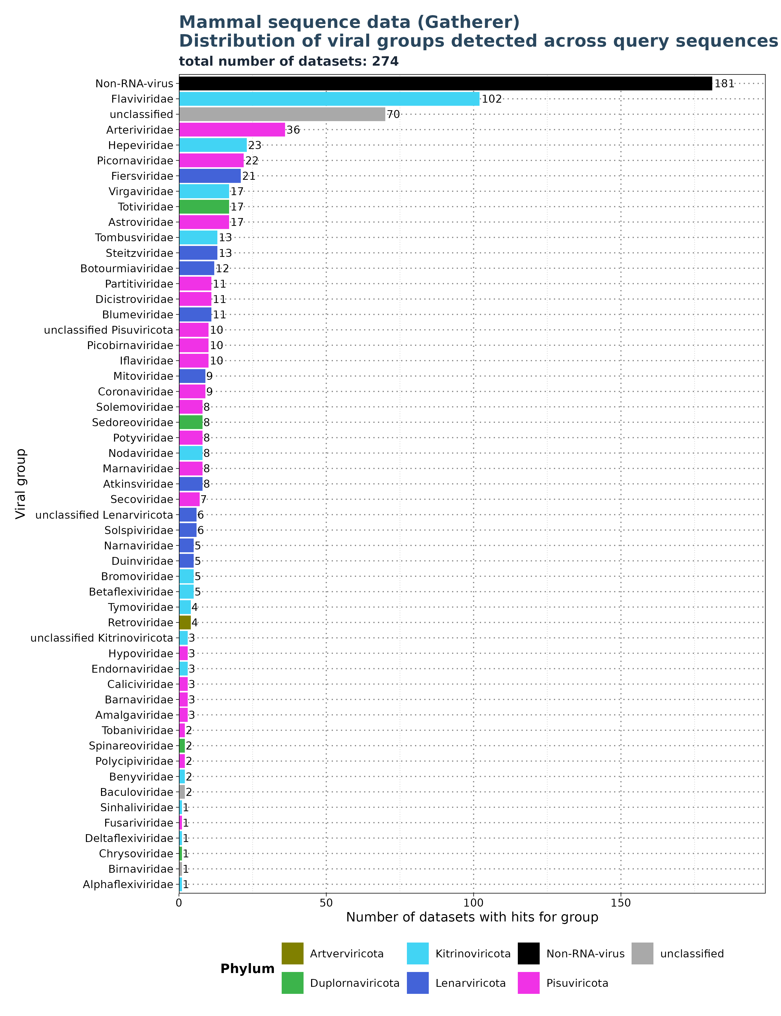
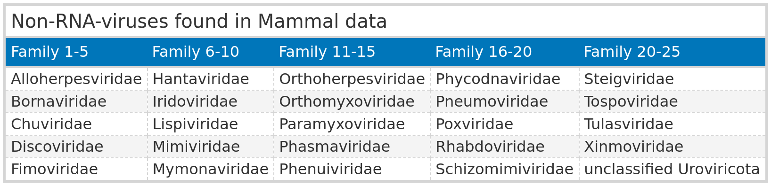
Results: Mammal
Distribution of groups across queries
Filtered for significant observations (E-value < 1e-5)

Slide 21
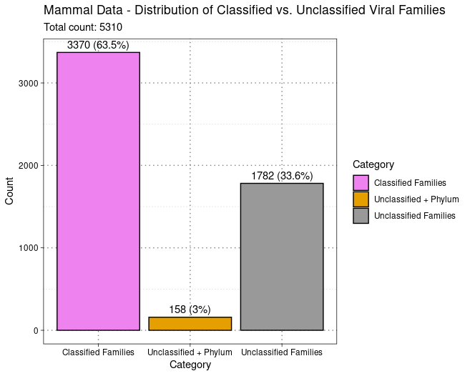
Results: Mammal
classified vs unclassified
Viral Family extracted from
ViralRefSeq_taxonomy column
- 5310 observations for 274 unique SRA IDs.

Slide 22
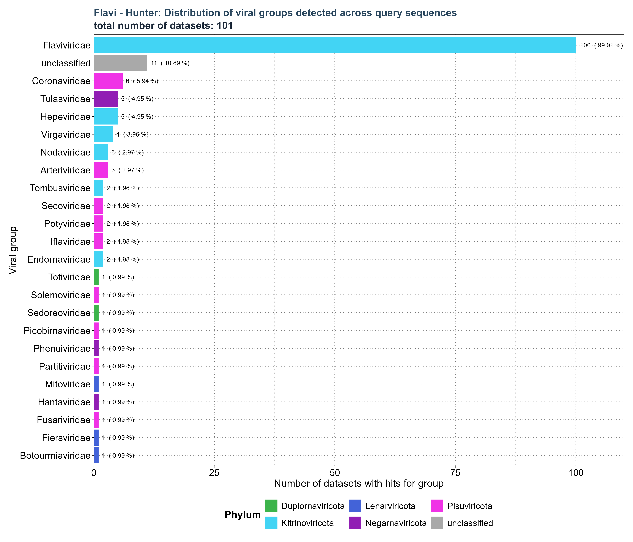
Results: Mammal
Non-Family Specific Profiles
Search for: Flavi_RdRp

Slide 23
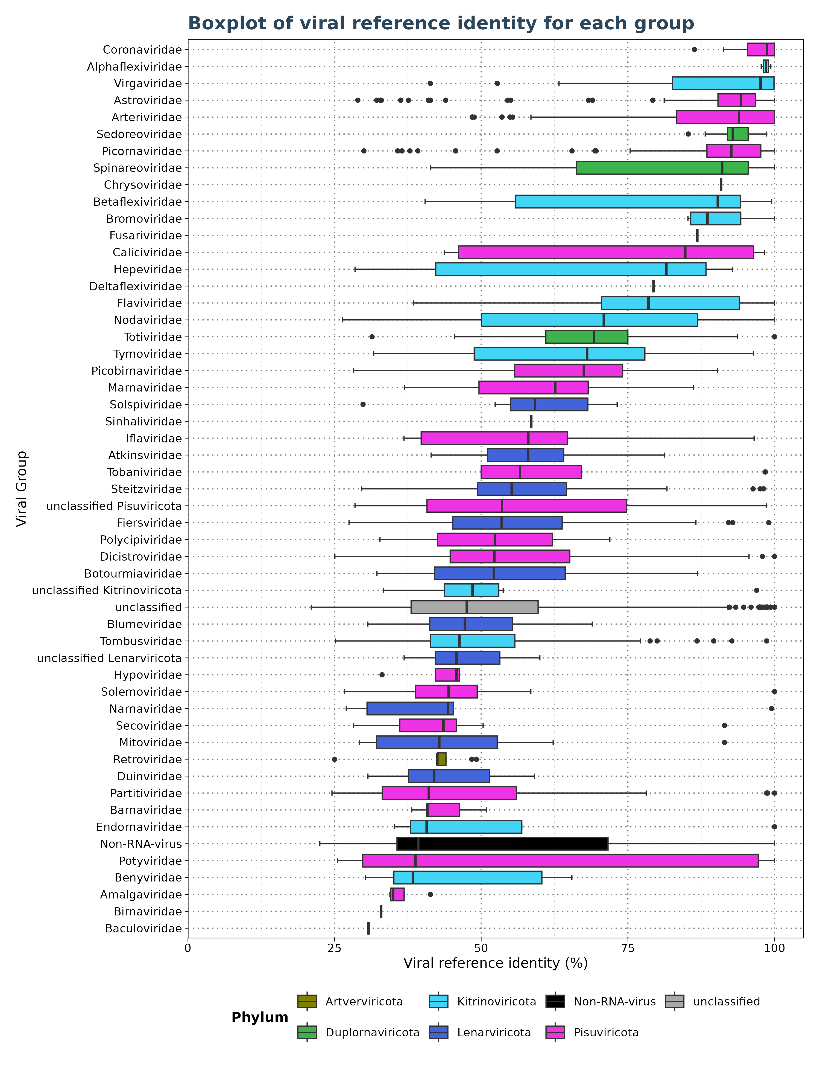
Results: Mammal
Identity
Filtered for significant observations (E-value < 1e-5)

Slide 24
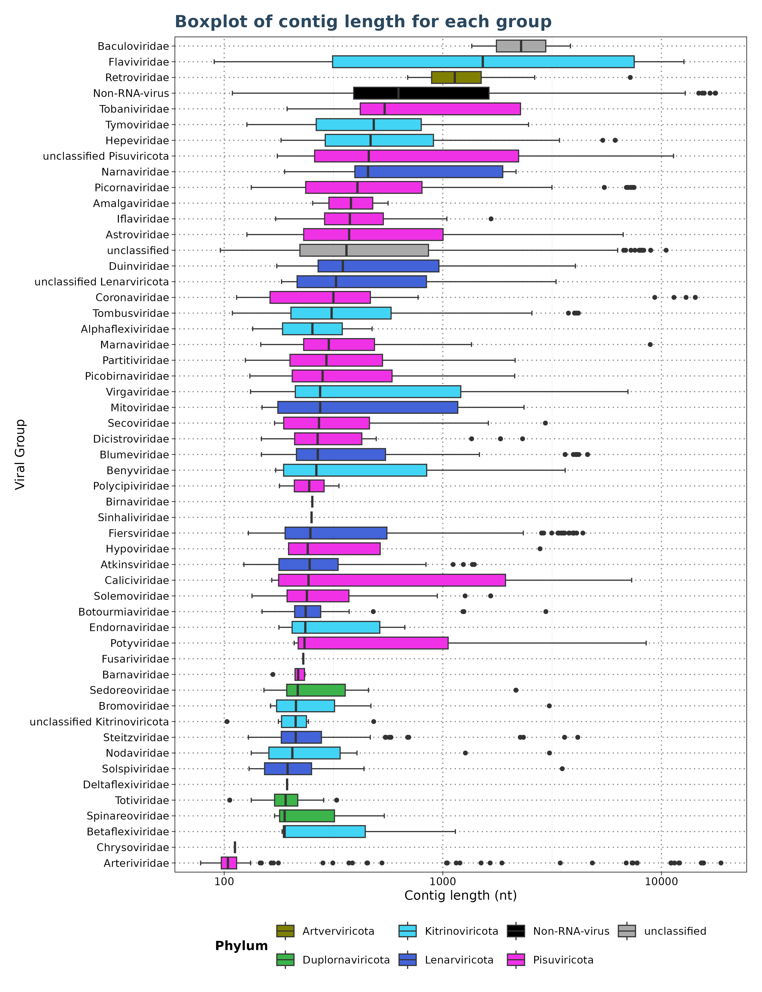
Results: Mammal
Contig Length
Filtered for significant observations (E-value < 1e-5)

Slide 25
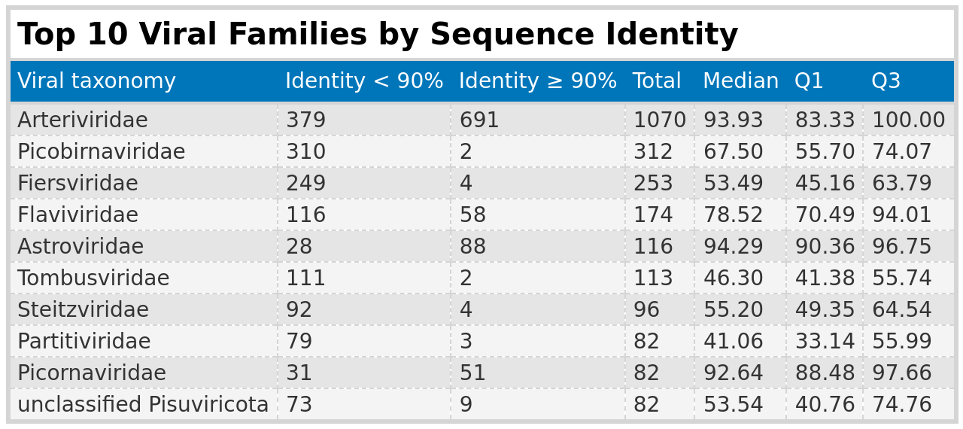
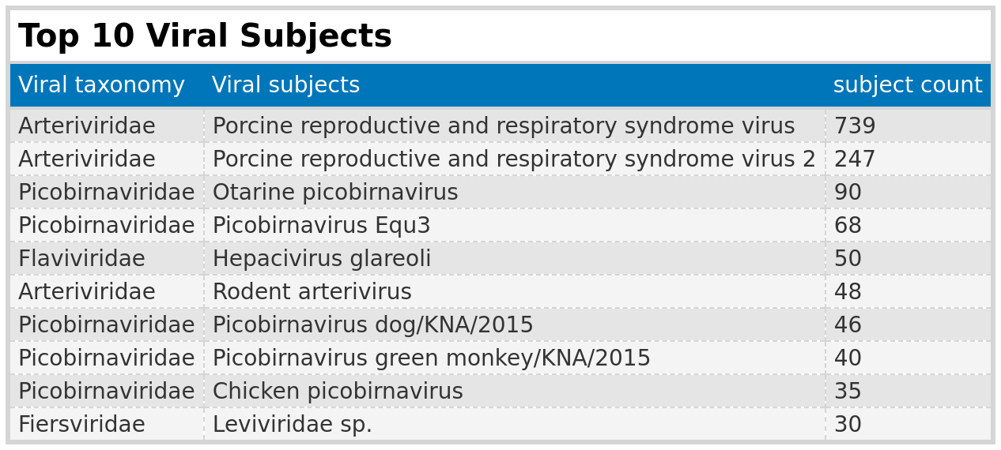
Results: Mammal

Slide 26
Results: Mammal
Summary
Classification Issues: 36% of viral taxa could not be classified due to missing information on viral families
Cross-Group Findings: 25 non-RNA viruses were identified
Profile Specificity: profiles are not specific to one family
Flaviviridae:
Data Sets: 102 (174 obs.)
Identity: 67% < 90%, median 78%
Contig Length: 90 - 12,688 nt, median 1,524 nt
Arteriviridae:
Data Sets: 36 (1,070 obs.)
Identity: 35% < 90%, median 94%
Contig Length: 87 – 18,735 nt, median 104 nt
Picobirnaviridae:
Data Sets: 10 (312 obs.)
Identity: 99.4% < 90%, median 67.5%
Contig Length: 131 – 2,134 nt, median 282 nt

Slide 27
Results: Florian Pfaff

Slide 28
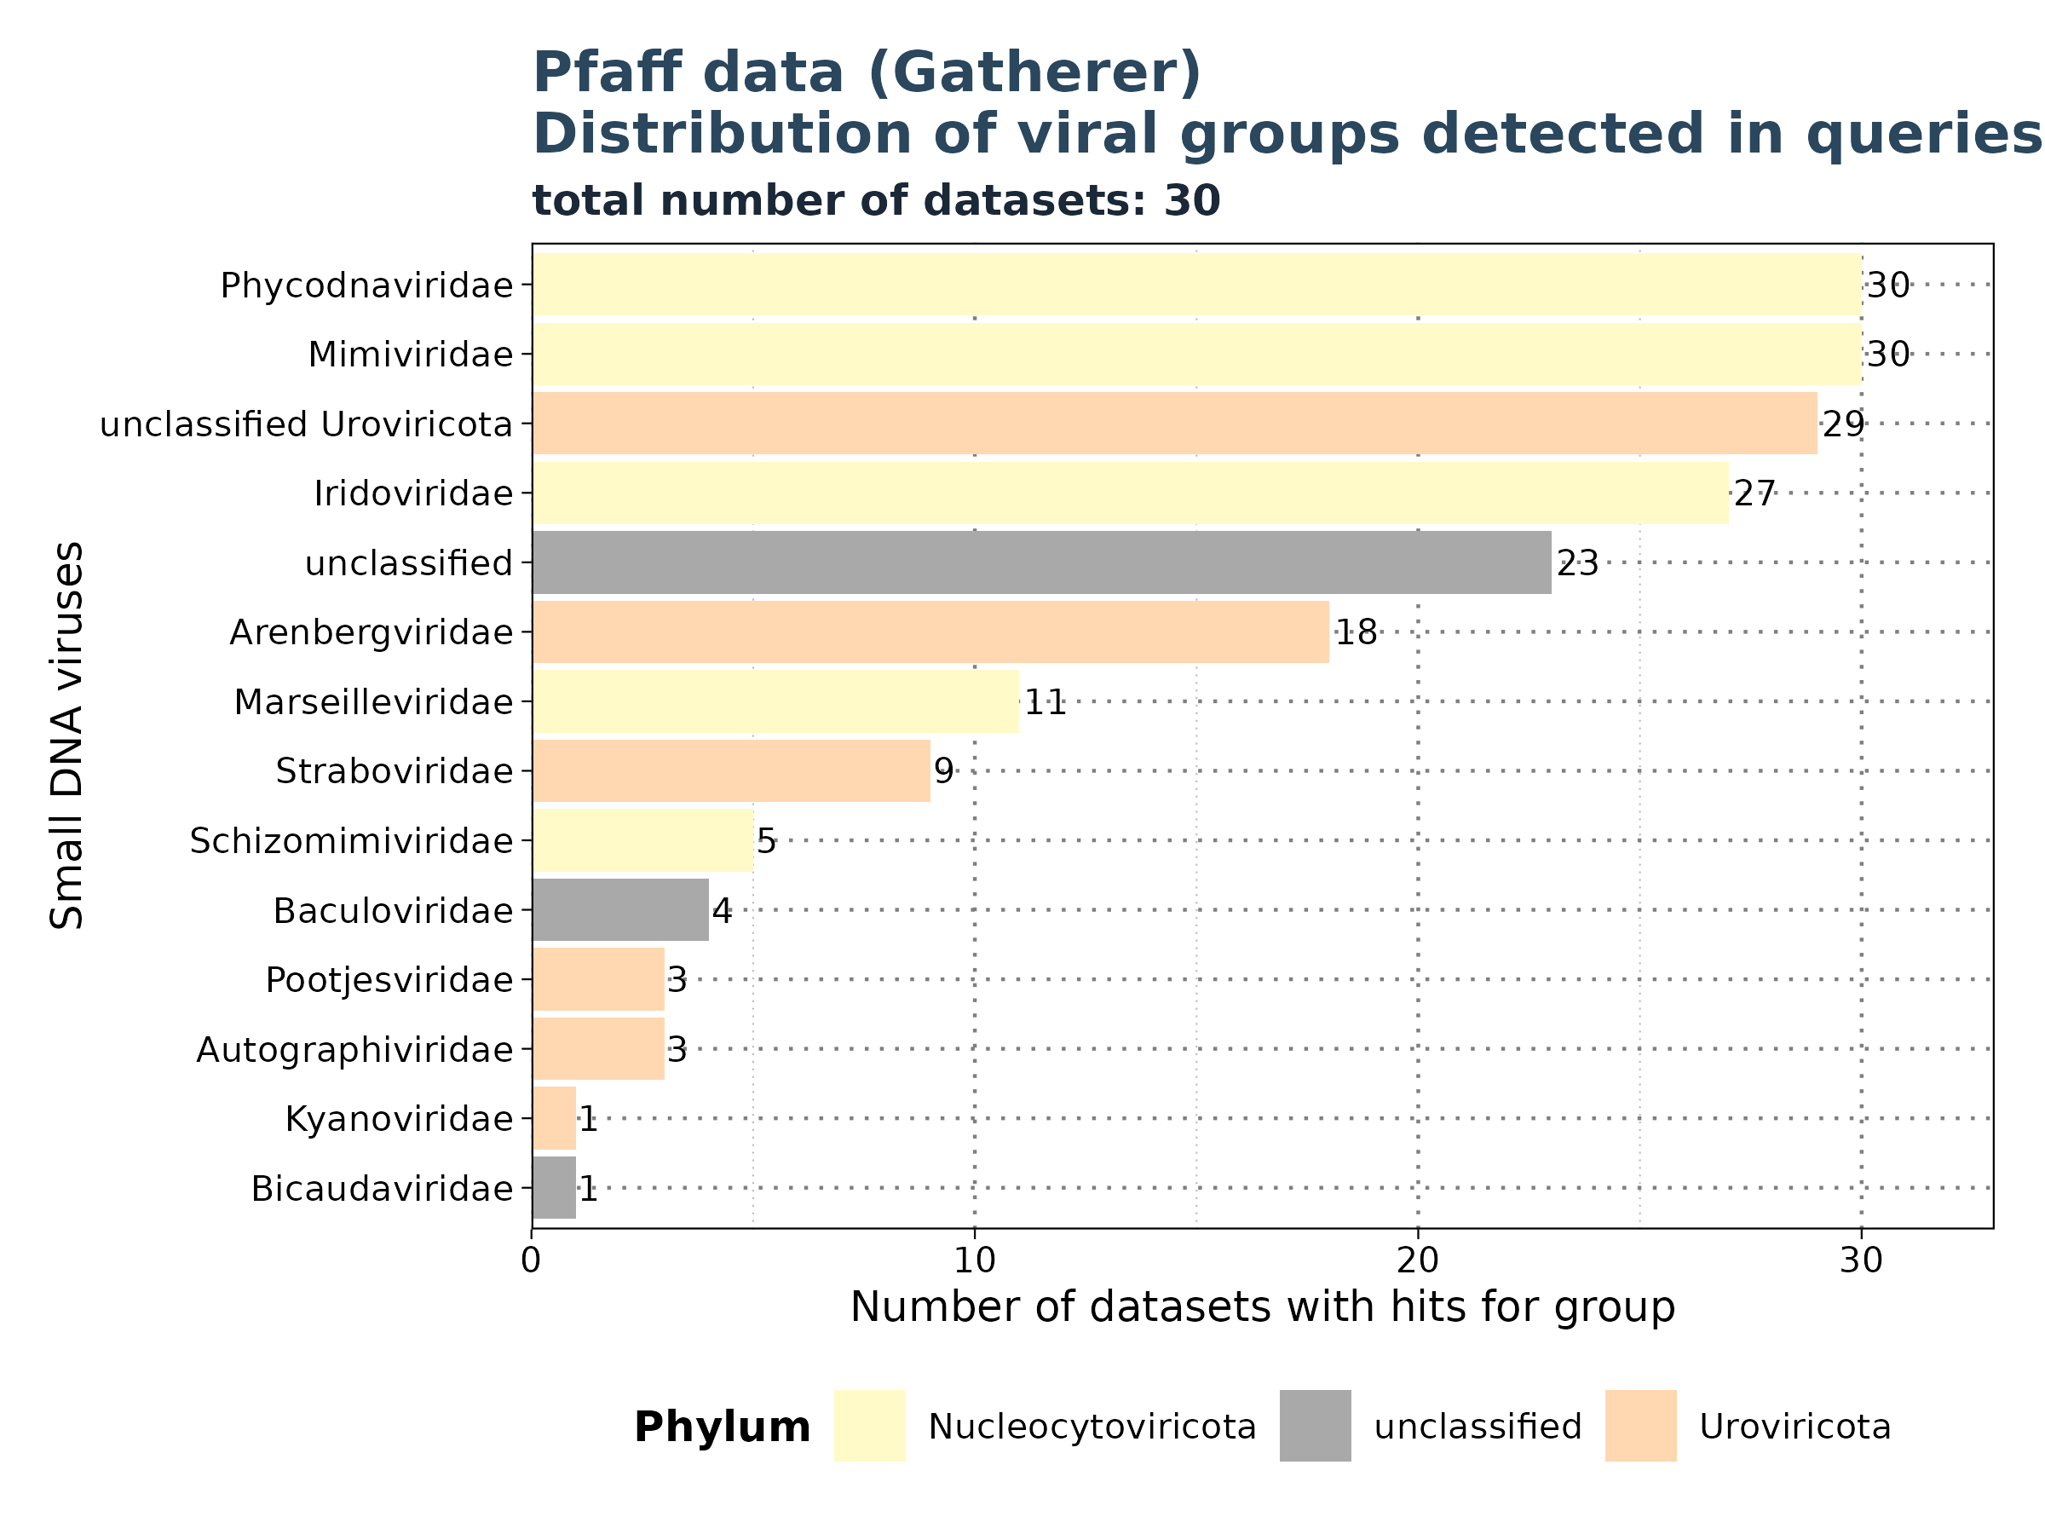
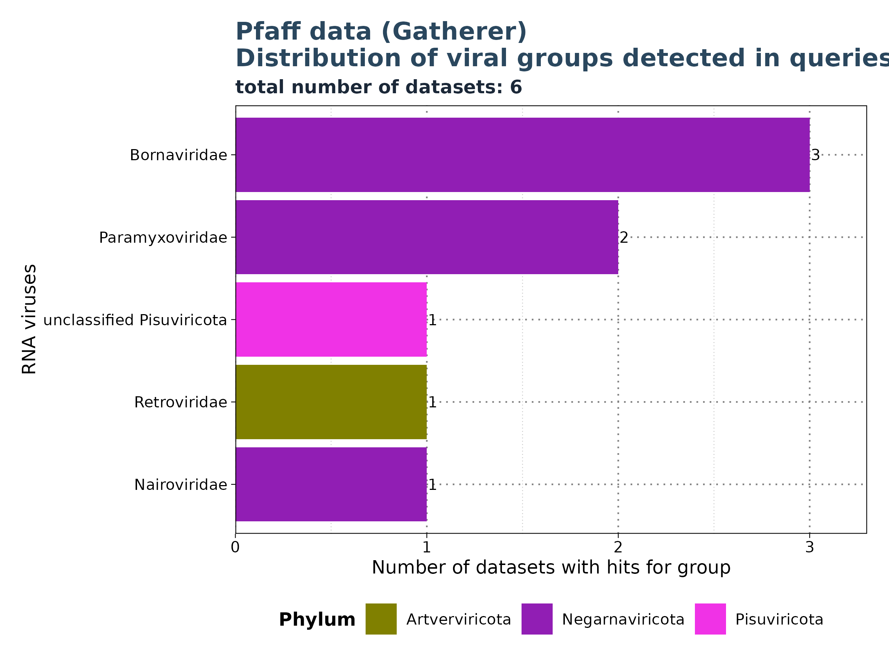
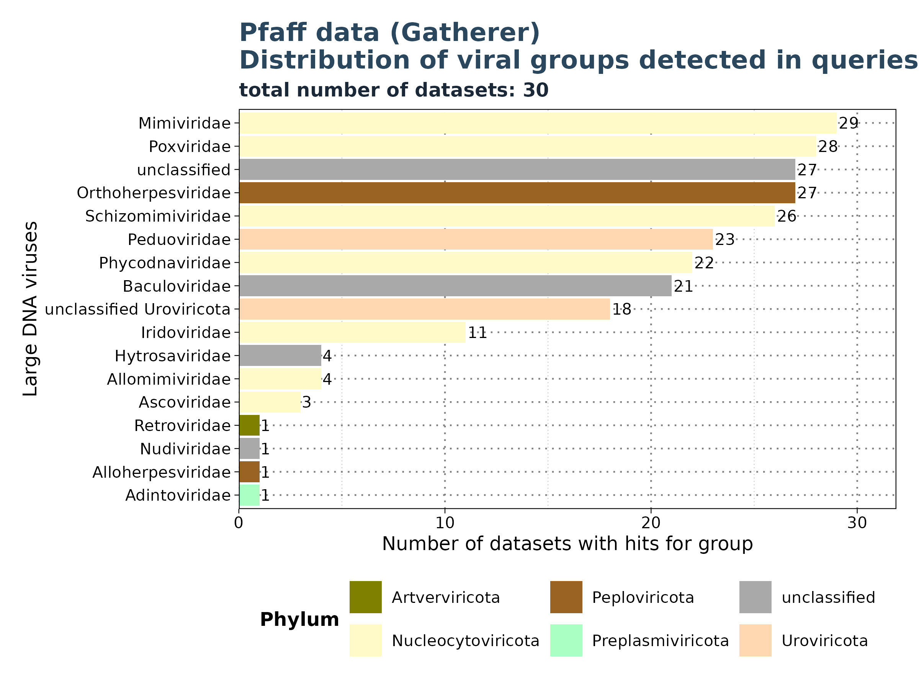
Results: Pfaff Data
Distribution of groups across queries
Filtered for significant observations (E-value < 1e-5)

Slide 29
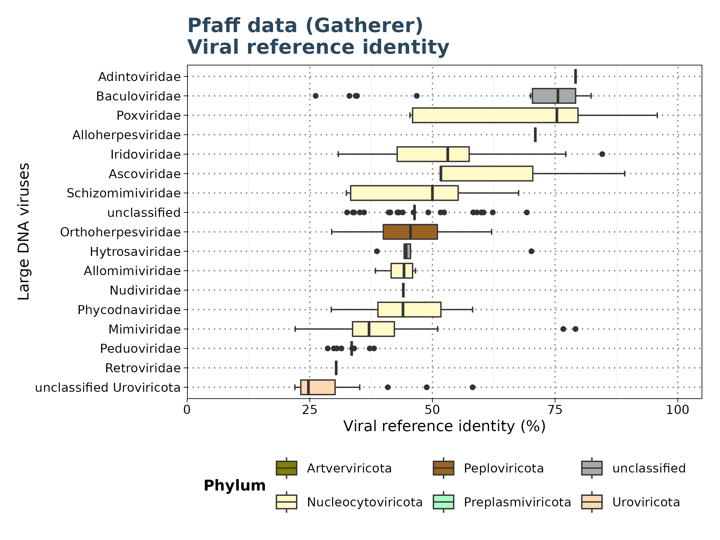
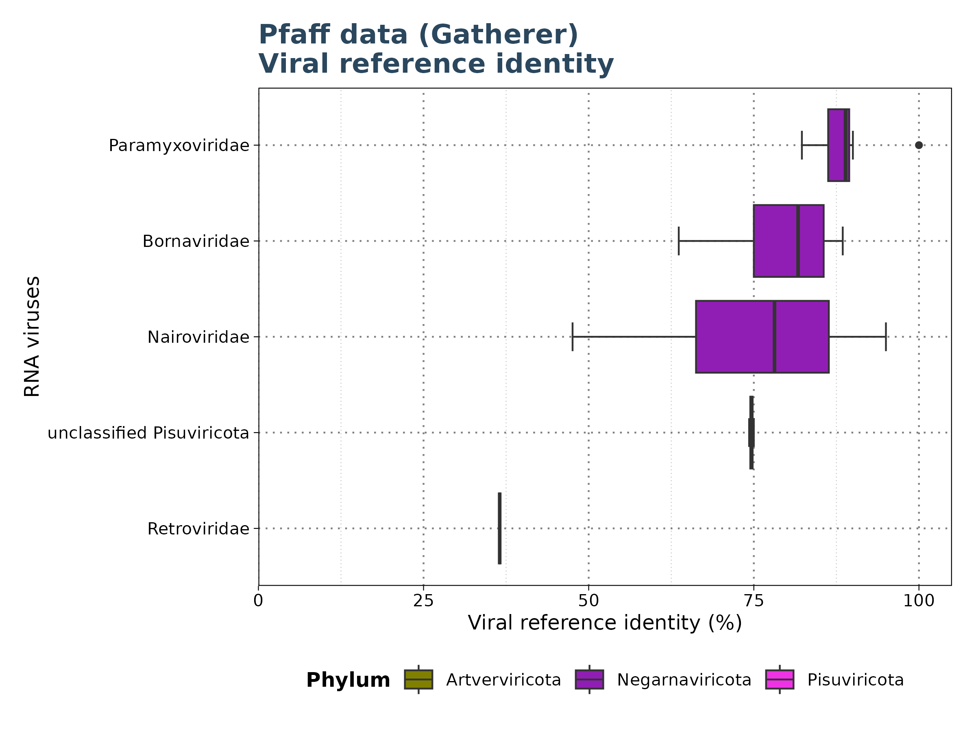
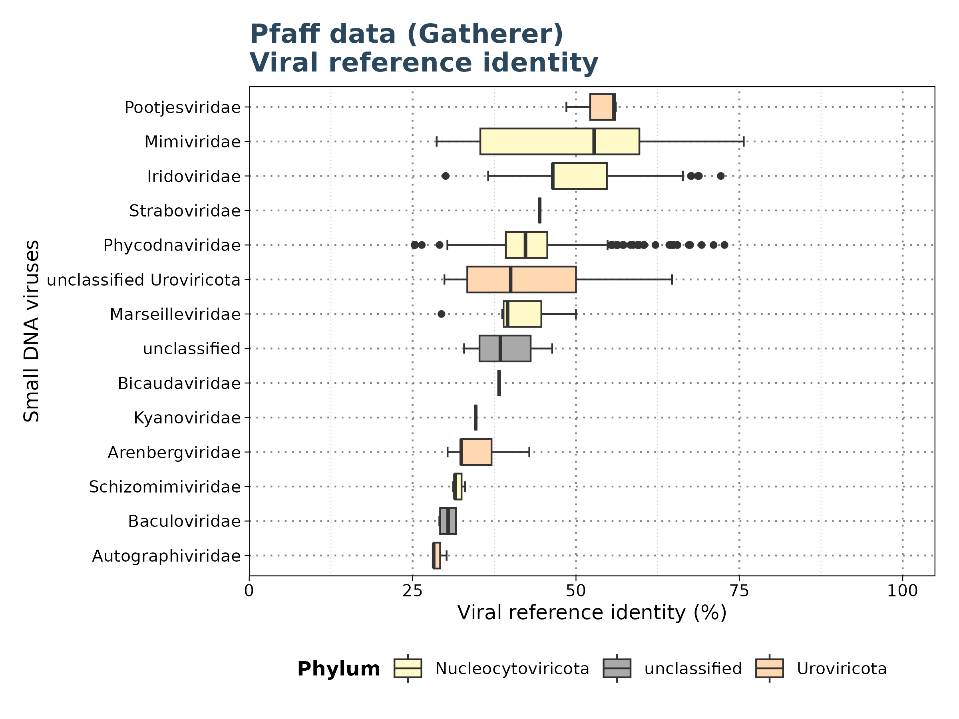
Results: Pfaff
Identity
Filtered for significant observations (E-value < 1e-5)

Slide 30
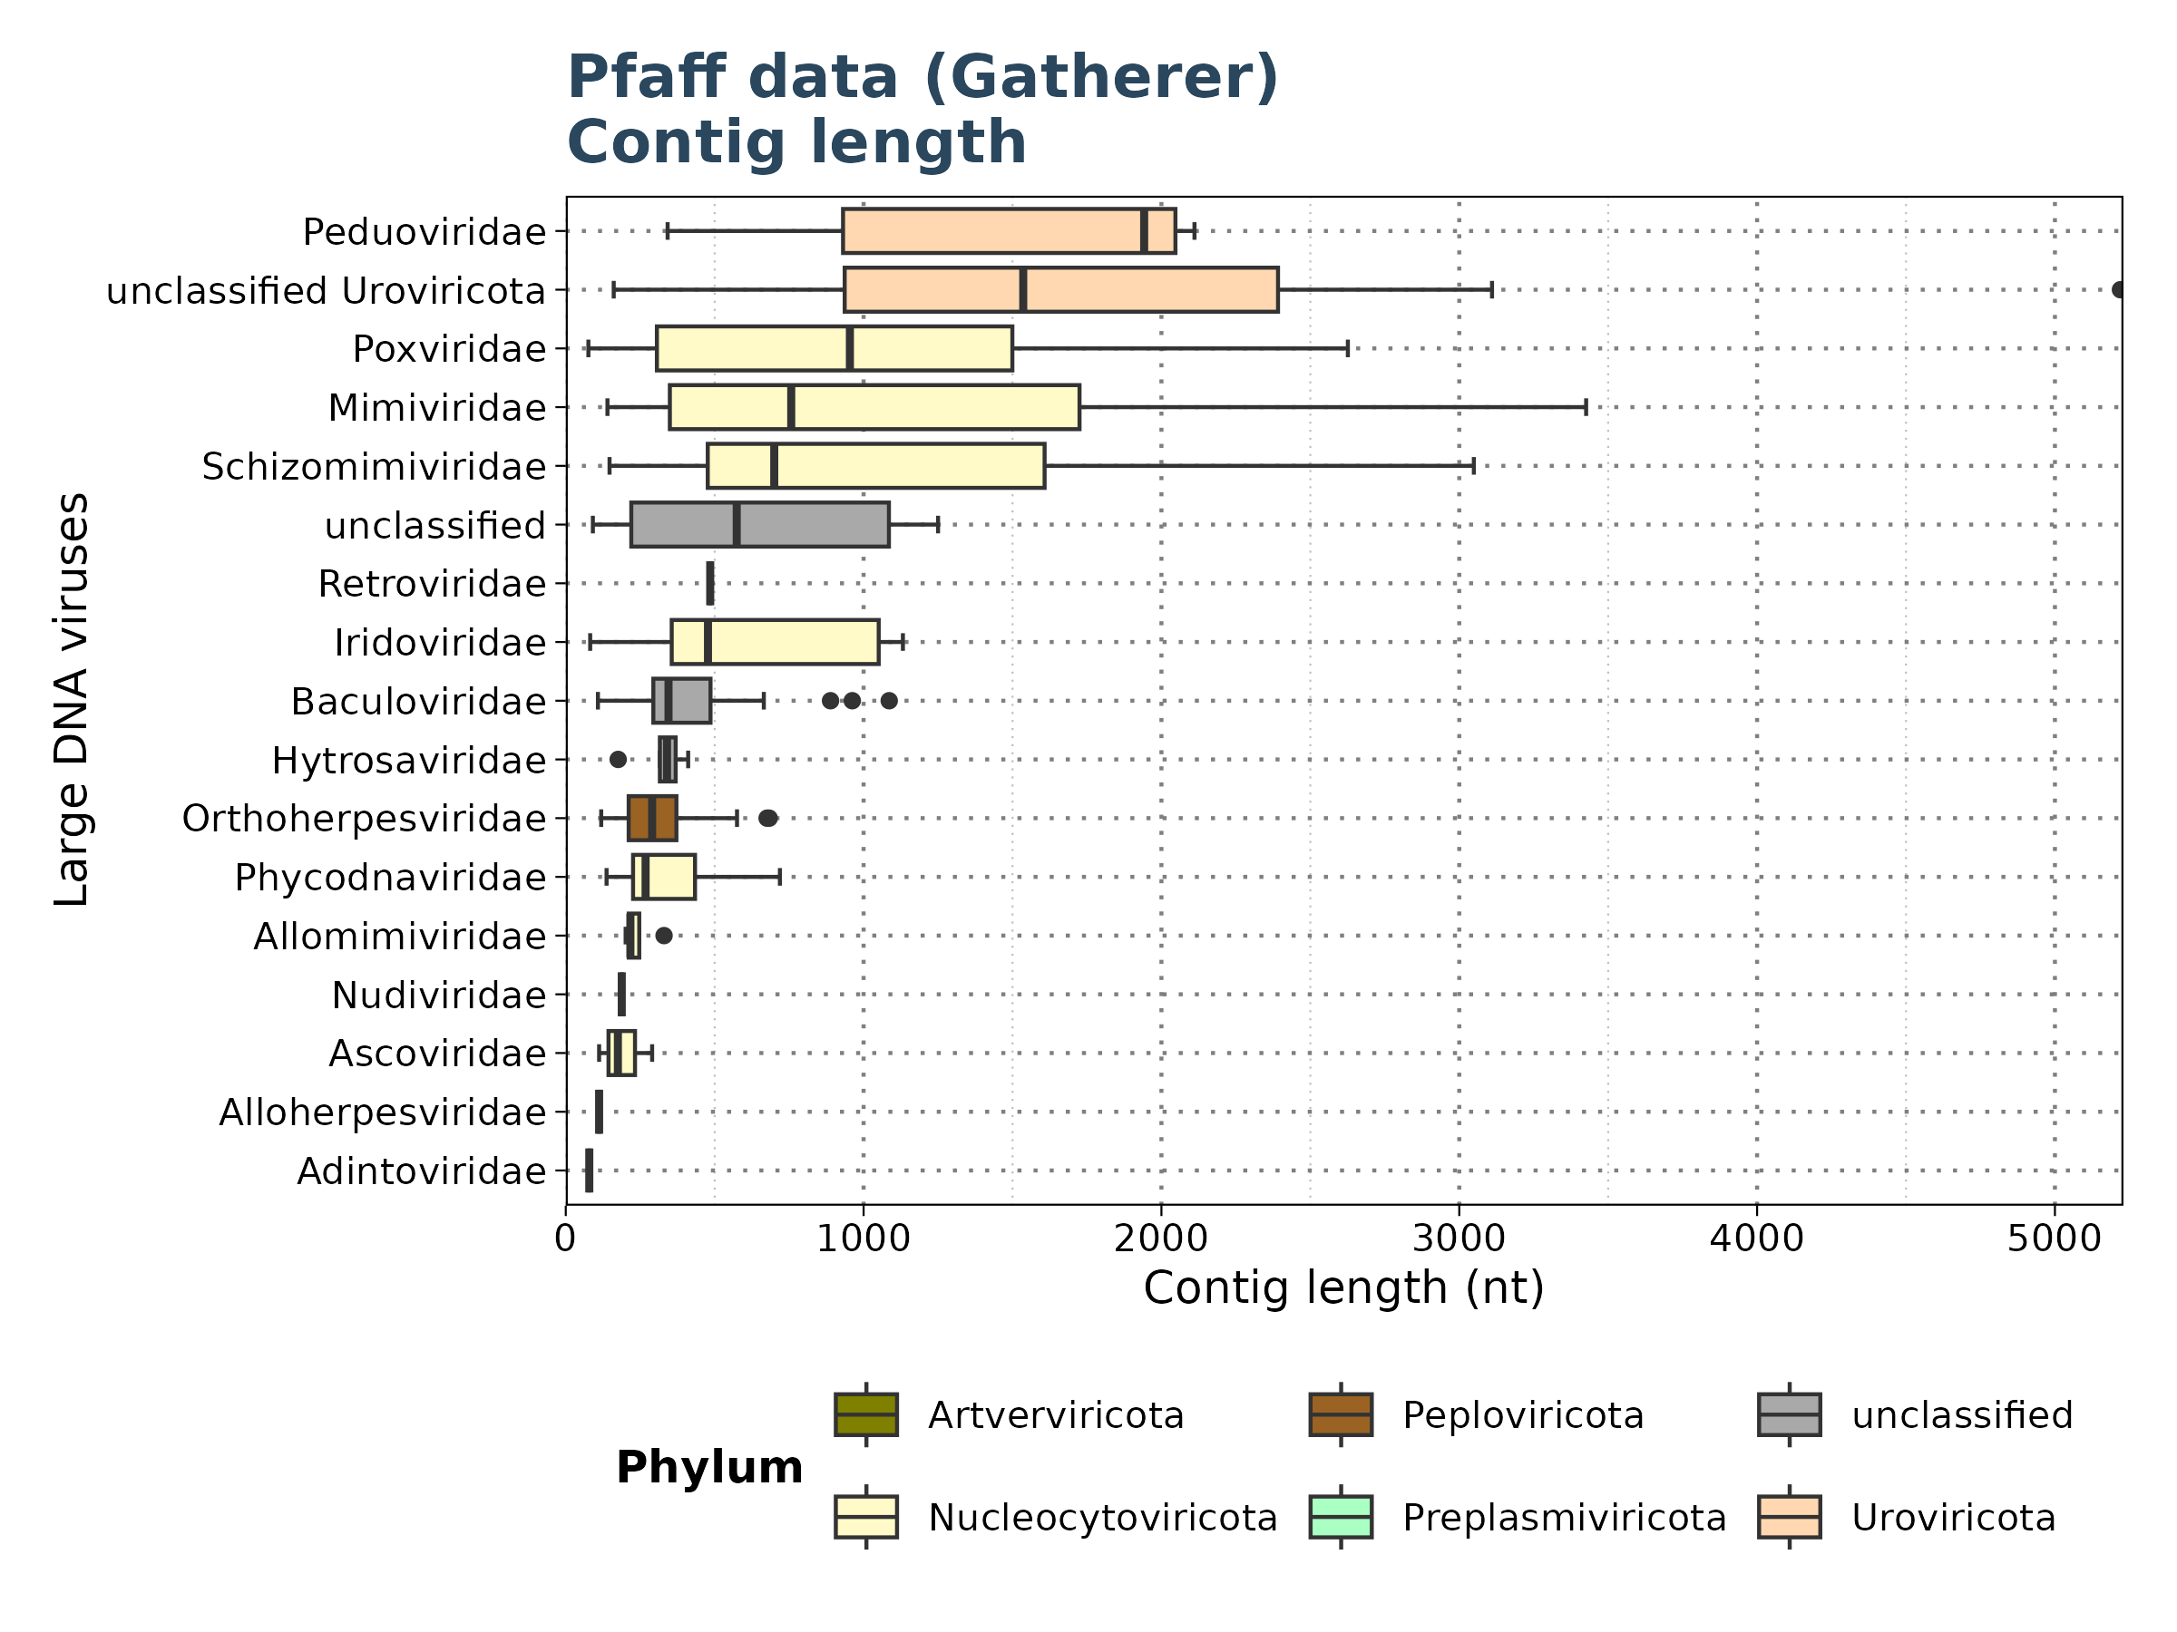
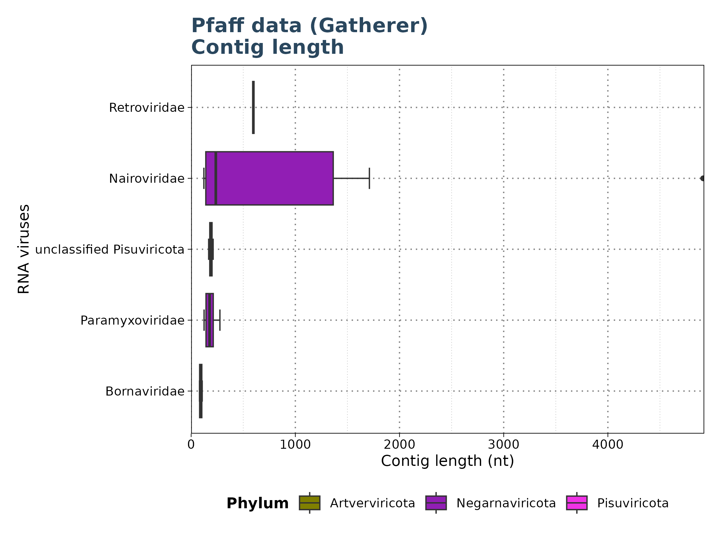
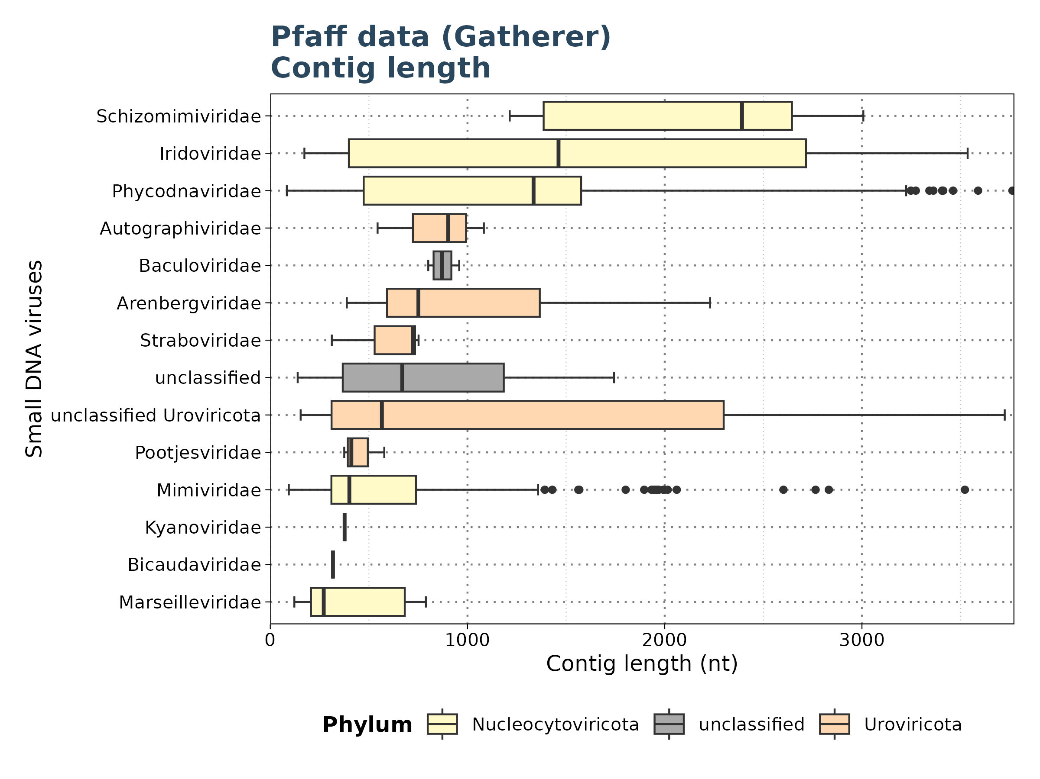
Results: Pfaff Data
Contig Length
Filtered for significant observations (E-value < 1e-5)

Slide 31
Results: Pfaff Data
Summary
Comparison of Taubert and Pfaff Data:
Pfaff Data: 30 out of 32 files yielded significant results
Taubert Data: Only up to 6 out of 557 files showed significant results
Note: Potential impact of Taubert data not being preprocessed for viral discovery?

Slide 32

Results: Virusparies
18 Functions:
1 function to import hittables
6 plot functions (box plots, violin plots, bar plots, scatter plots and bubble plots)
2 functions to generate graphical tables
3 export functions
6 utils functions (subset hittable,combine hittables,extract group of interest from taxonomy column, add phylum information,and perform summary statistics).

Slide 33
Concluson and Outlook

Slide 34
Concluson and Outlook
Conclusion:
Taubert Data: Analysis complete with only up to 6 files showing significant results; issues include E-values near cutoff, false positives, high identity, and short contig lengths.
Mammal Data: Notable classification issues and interesting viral families identified.
Pfaff Data: Preprocessing impact on viral discovery remains to be assessed.
Cross-Group Findings: Observed across all experiments.
Ongoing: Two mammal runs are currently running on Aeternitas.
Next Steps:
Analyze additional mammalian viruses.
Create gene maps or a phylogenetic tree for a group of interest.
Submit Virusparies to Bioconductor.
Write master’s thesis.

Slide 35
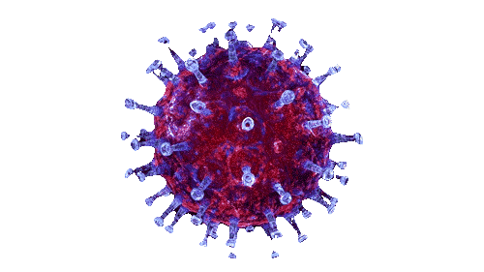
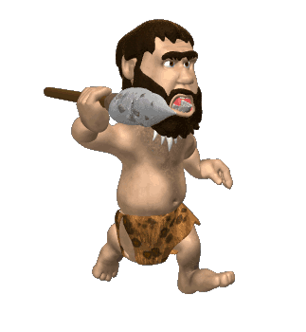
Thank you for your time Questions?

